Slide 1



202X
Online Shopping AI Platform Project Presentation
Team members
Ke Zhang
2025.4
POWERPOINT DESIGN
Xingguang Chen

Slide 2
1.
Project Introduction
Catalogue
2.
Persona Analysis
3.
User Journeys
4.
Sitemap
5.
Low-Fidelity Mockups
6.
Design Principles & System Design
7.
Code and Functionality Demonstration
8.
Future Plans and Team Learnings

Slide 3
01
Part
Project Introduction
POWERPOINT DESIGN

Slide 4
Project Overview
01
02
Project Name
Project Objective
Online Shopping AI This project aims to develop a comprehensive online shopping solution.
Create a user- friendly online shopping website. The goal is to provide an intuitive and efficient shopping experience.
03
04
Target Users
Expected Outcome
Online shoppers seeking quick product discovery and purchase. The platform is designed for users who value convenience and speed.
Seamless shopping experience with key functionalities. Users can browse products, manage carts, and log in effortlessly. AI provides product comparison and purchase suggestions.

Slide 5
02
Part
Persona Analysis
POWERPOINT DESIGN

Slide 6
Persona 1: Alice
Alice's Profile
Alice's Needs
Alice's Pain Points
Name: Alice Age: 28 Occupation: Office worker Alice is a busy professional looking for efficient shopping solutions.
Needs: Quickly find products and complete purchases. Alice prioritizes speed and ease in her shopping process.
Pain Points: Alice often struggles to compare features and prices across different items. She avoids websites that lack clear side-by-side comparisons or filters for quick evaluation.

Slide 7
Persona 2: Bob
Bob's Profile
Bob's Pain Points
Name: Bob Age: 35 Occupation: Freelancer Bob values personalized experiences and efficiency.
Pain Points: Bob often feels overwhelmed by too many options without clear guidance. He prefers platforms that offer smart recommendations or product highlights.
Bob's Needs
Needs: Wants personalized product recommendations. Bob seeks tailored suggestions to enhance his shopping journey.

Slide 8
03
Part
User Journeys
POWERPOINT DESIGN

Slide 9
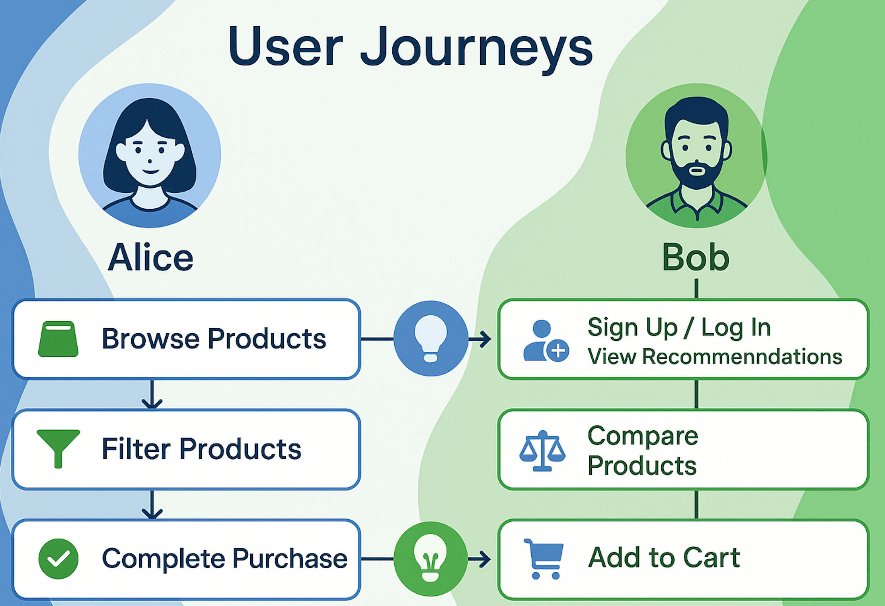
User Journey
Alice's Journey
Opportunities for Improvement
Alice browses products and completes a purchase. Alice navigates through the website to find and buy desired items.
Opportunity 1: Optimize the product search functionality. Enhance search algorithms to help Alice find products faster. Opportunity 2: Simplify the checkout process. Streamline checkout steps to reduce Alice's effort and time.
Bob's Journey
Opportunities for Improvement
Bob registers and views recommended products. Bob signs up and explores personalized product suggestions.
Opportunity 1: Provide a quick registration option. Implement social media login to make registration seamless for Bob. Opportunity 2: Improve the recommendation algorithm. Refine the algorithm to offer more accurate and relevant recommendations.

Slide 10
04
Part
Sitemap
POWERPOINT DESIGN

Slide 11
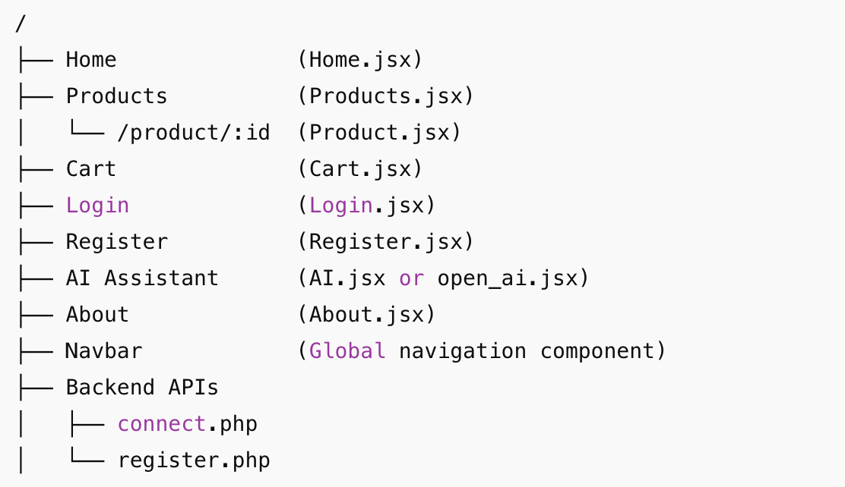
Sitemap
Home
-Trending and popular items.
-Register: User registration.
-Login: User login.
-Cart: View and manage the shopping cart.
Products
About
AI
Men's Clothing
Post1
-Compare products
-Give Recommendations
Women's Clothing
Post2
.
Jewelry
Electronic

Slide 12
Flowchart
Navigation Flow
Flowchart: Users log in and navigate from the home page to the product page.
Users add items to the cart
Users complete the compare process by AI. Then they complete purchase.

Slide 13
05
Part
Low-resolution Mockups
POWERPOINT DESIGN

Slide 14
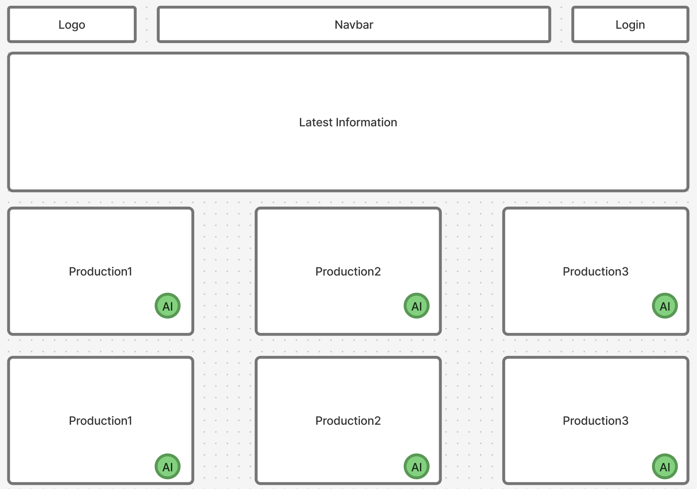
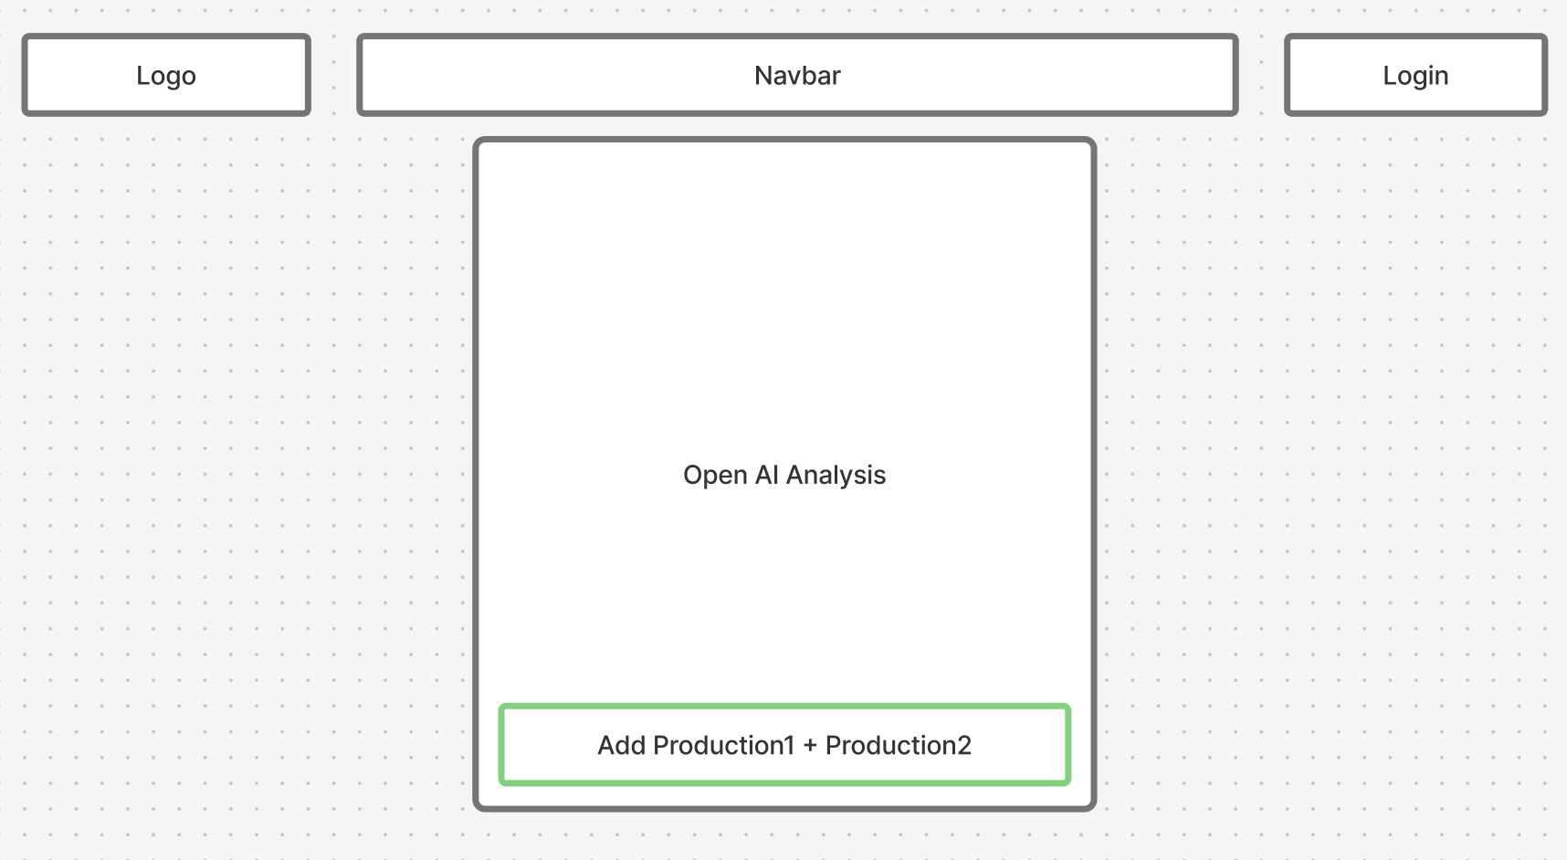
Home Page Mockup
Home Page Design
Home Page Mockup: Includes a navigation bar and a product list.
The navigation bar provides easy access to all key sections.
The product list highlights featured and trending items with AI.
01
02
03

Slide 15
06
Part
Design Principles & System Design
POWERPOINT DESIGN

Slide 16
Typography and Color
Color Palette
Typography
Primary Color: Blue (to convey trust). Secondary Colors: White and gray. White and gray provide a clean and modern style.
Use a clear and easy font to read across devices. .
Design Principles
Focus on user experience, ensuring the interface is clean and easy to use.
Focus on a clear and easy-to-use design

Slide 17
System Design and Architecture
Frontend Design
Backend Design
Framework:
React 19: For building the user interface
Redux Toolkit: For managing global state
React Router DOM: For enabling multi-page navigation
Styling:
Bootstrap 5.3.5: Responsive layout and components
Font Awesome 4.7: Icon support
Core Features:
Product Listing: Dynamically fetch and display products
Comparison Feature: Add products to a comparison list and view results
Shopping Cart: Allow users to manage selected items
API Data Source:
Free public Web API for product data
Functions:
GET Products: Provide product list via HTTP requests
Comparison Support: Handle data exchange for comparison functionality
Data Format:
JSON structure for all product data responses

Slide 18
07
Part
Code and Functionality Demonstration
POWERPOINT DESIGN

Slide 19
Code Quality
Code Snippets
Code Quality: Show snippets of HTML, CSS, and JavaScript.
Clean and well- organized code ensures smooth functionality.

Slide 20
Functionality Demonstration
Key Features
https://super-hotteok-14c488.netlify.app/
01
Product browsing.
04
Users can manage their shopping cart with ease.
02
Users can easily navigate through the product catalog.
05
User login and registration.
03
Cart management.
06
AI provides product comparison and purchase suggestions.
GitHub Repository:
https://github.com/OnetoTommy/Web_Design/tree/main/Web/Final_Project/shop_page

Slide 21
08
Part
Future Plans and Team Learnings
POWERPOINT DESIGN

Slide 22
Team Learnings
Team Development
Gained expertise in modern web development practices.
Enhanced collaboration through effective communication and coordination.
Team Learnings: Learned React routing and component- based development.
Team Learnings: Improved teamwork and collaboration skills.

Slide 23
Future Plans
Upcoming Enhancements
Add payment functionality.
Enhance the recommendation algorithm.
Add search functionality.
Improve the accuracy and relevance of product recommendations.

Slide 24
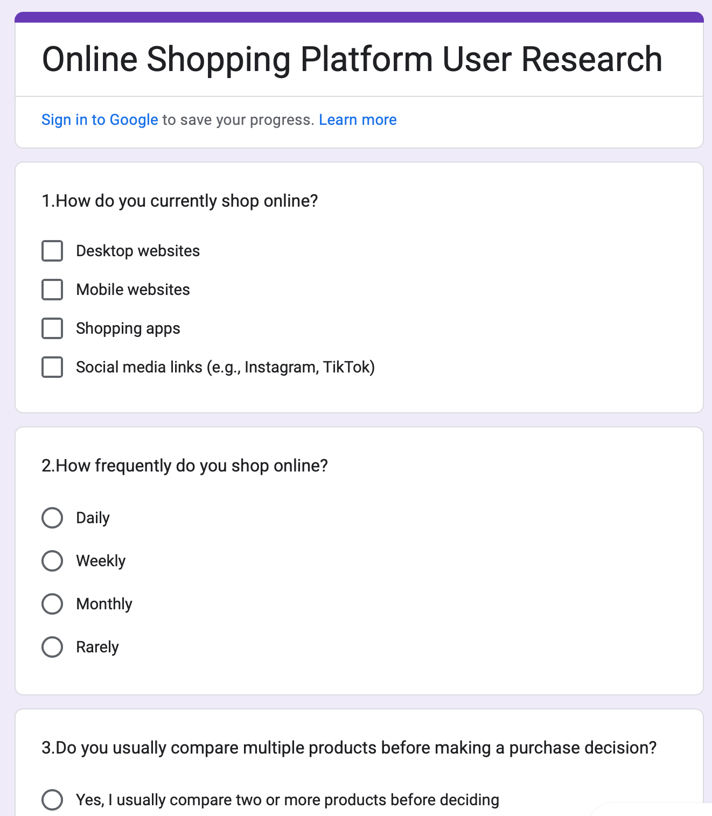
User Research & Survey Insights
https://docs.google.com/forms/d/1hJfacUY8oa08QGUUGBR81tA5LxHmW0v_E5eszKgLgnI/
Key Questions & Findings:
How do they currently shop? Desktop, Mobile, and Shopping Apps equally used (60%) How often do they shop? 70% shop weekly Do they compare products? 100% do – key aspects: Price (80%), Reviews (60%), Design (50%) Do they want AI help for comparison? 80% said Yes

Slide 25
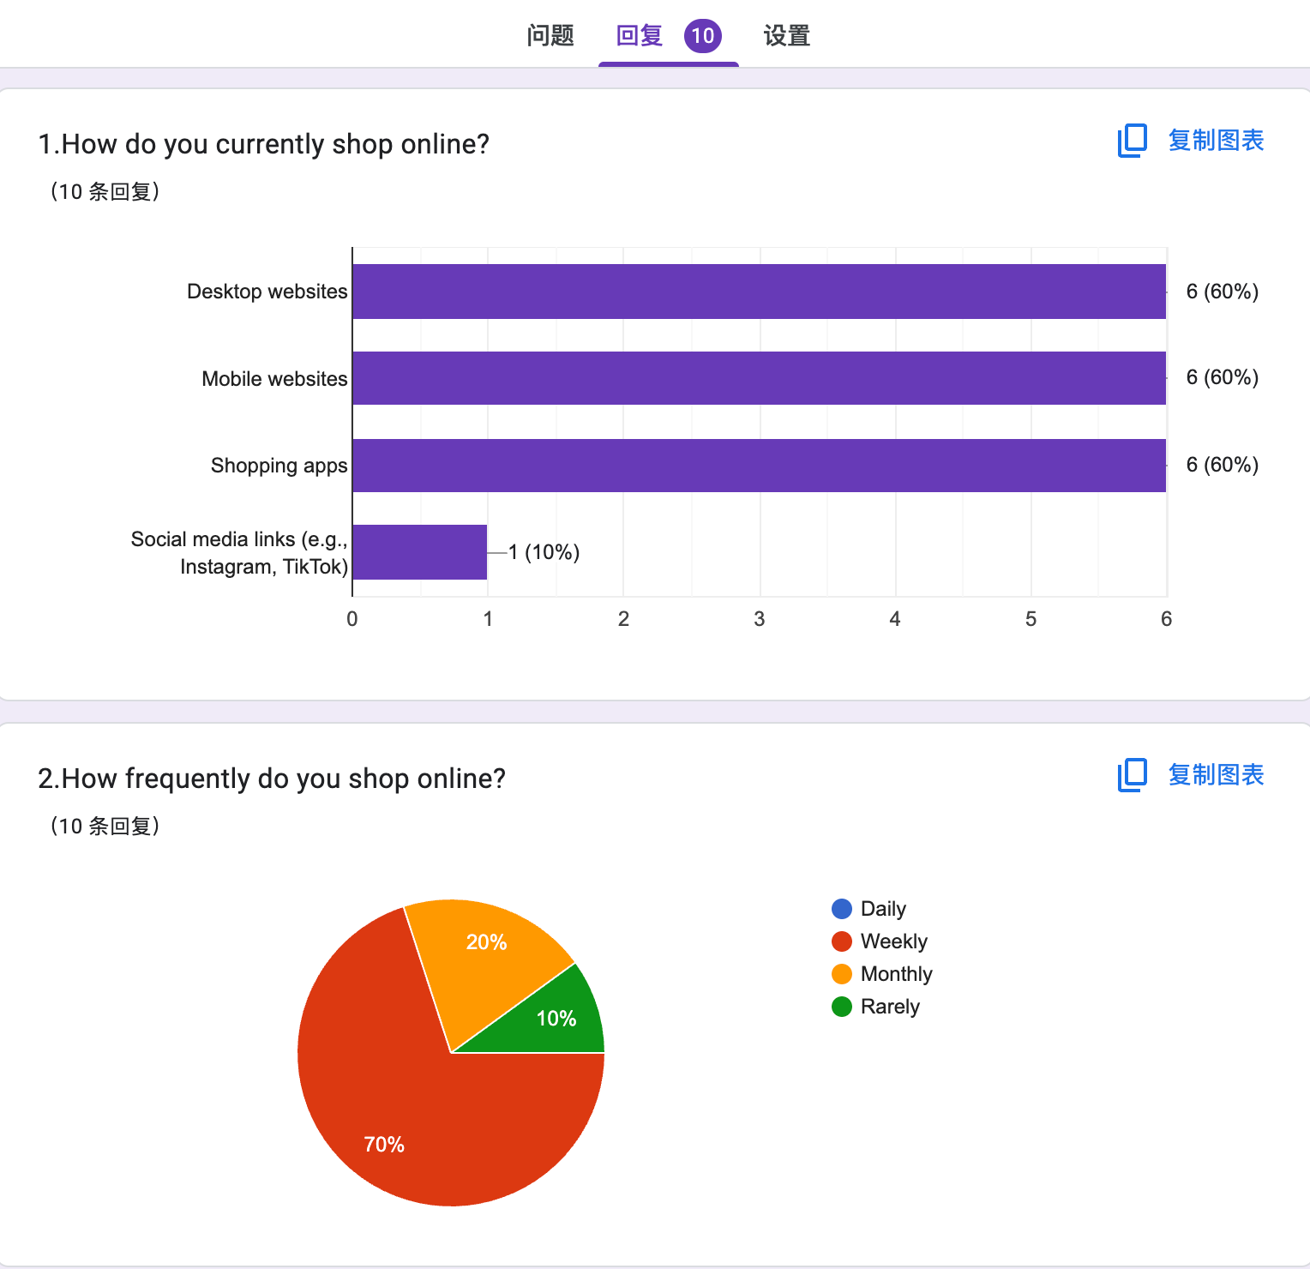
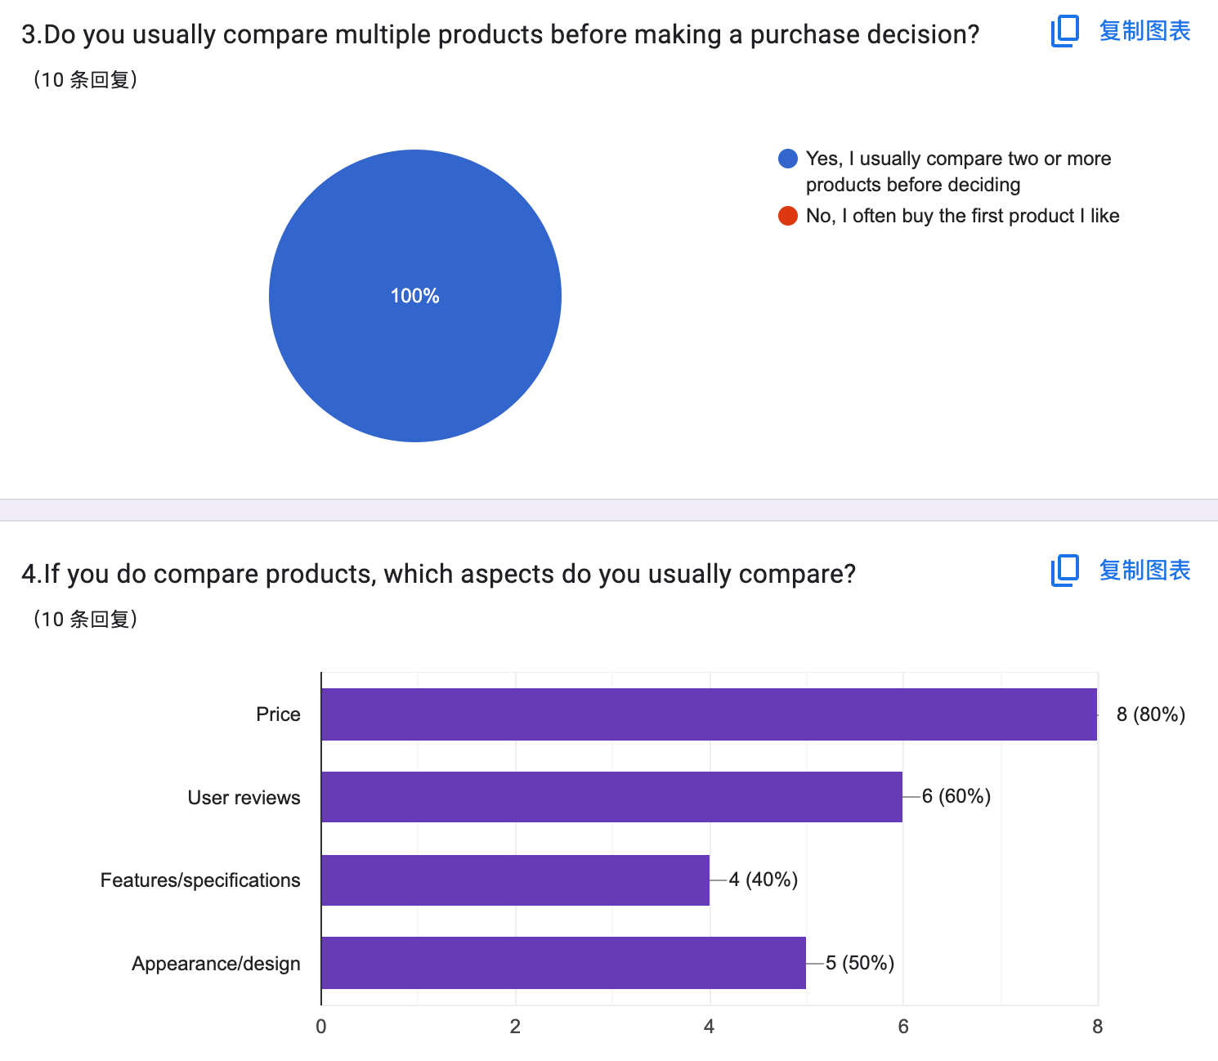
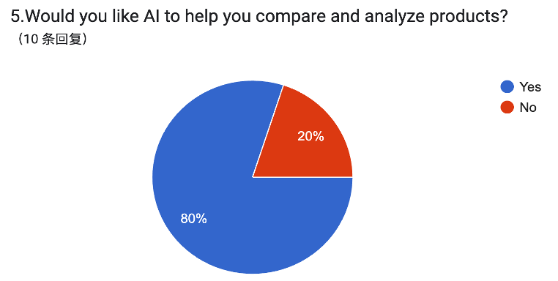
User Research & Survey Insights
Conclusion:
Users need help making informed decisions. An AI comparison feature is not only relevant, but strongly desired.

Slide 26
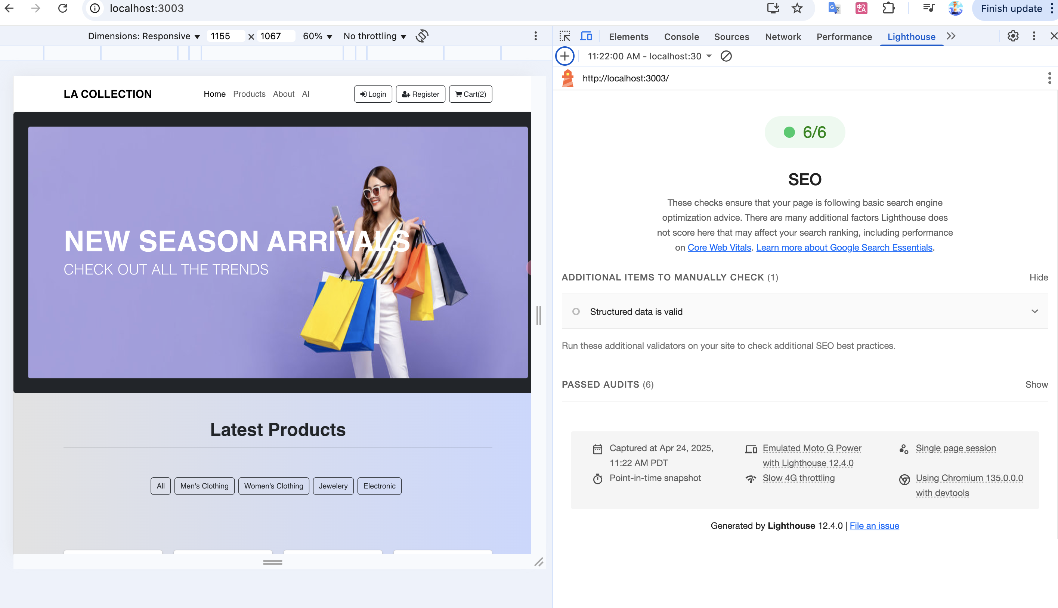
SEO Master
Goal:
Tool:
Optimize site for search engines using Lighthouse SEO audit
Chrome DevTools → Lighthouse → SEO
Approach:
Ran audit on mobile view with slow 4G Fixed key SEO elements (titles, meta, alt tags, structured data)

Slide 27
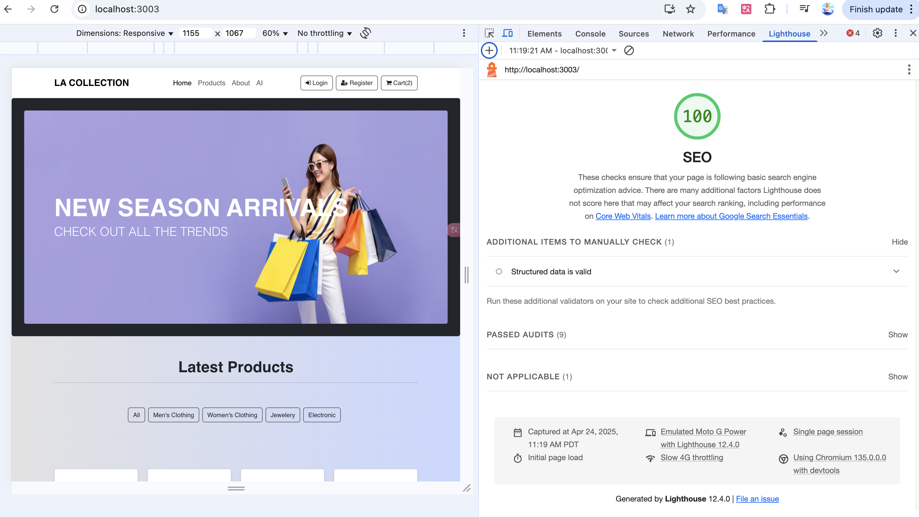
SEO Results
Lighthouse SEO score: 100
Title & meta description present Image alt tags added Structured data valid Mobile-friendly & accessible Canonical link + robots.txt set

Slide 28
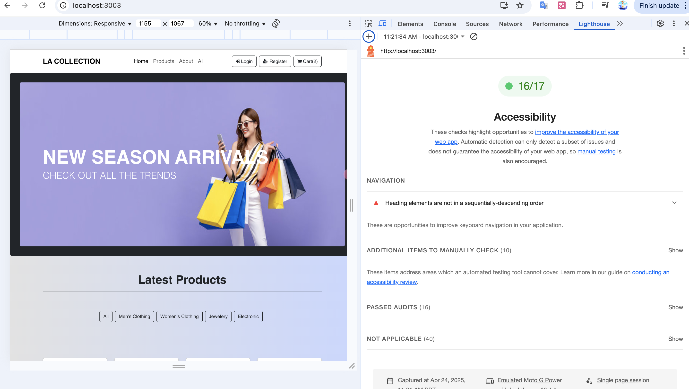
Accessibility master
Tool: Chrome DevTools → Lighthouse → Accessibility
Approach: Emulated Moto G Power Slow 4G, mobile-first testing
Passed 16/17 Accessibility checks
Objective: Improve website usability for all users, including those with disabilities.

Slide 29
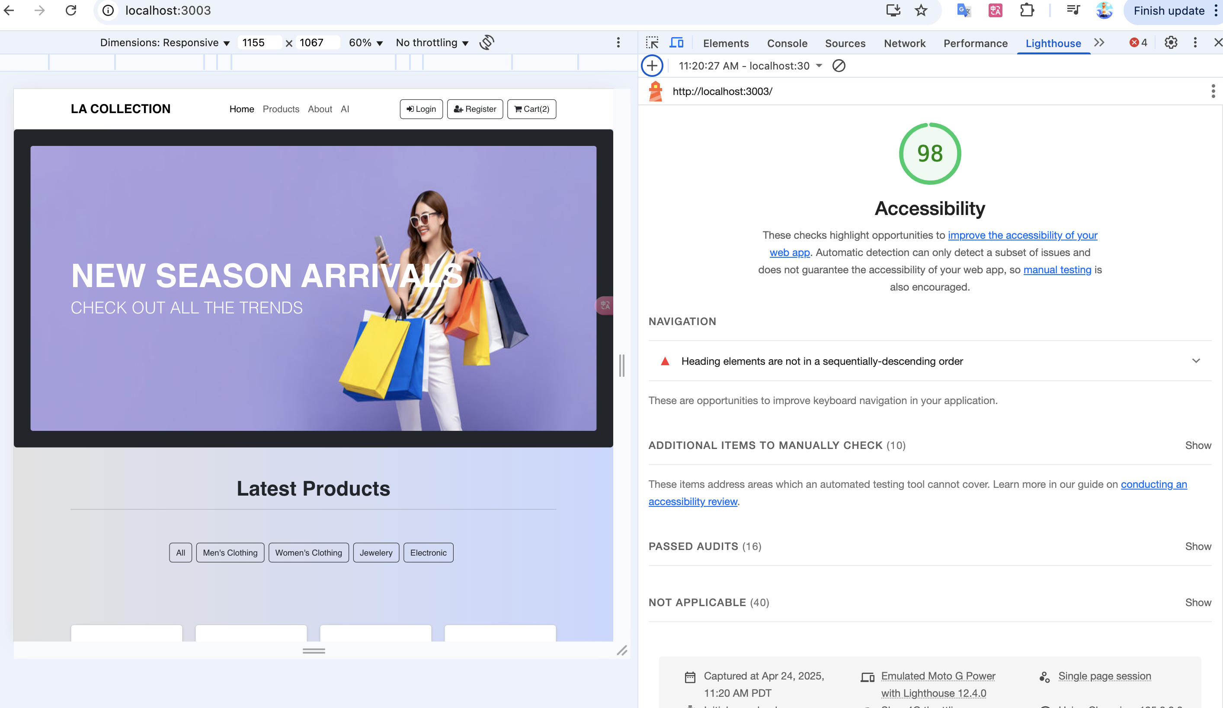
Accessibility Results & Score
Lighthouse score: 98 / 100

Slide 30
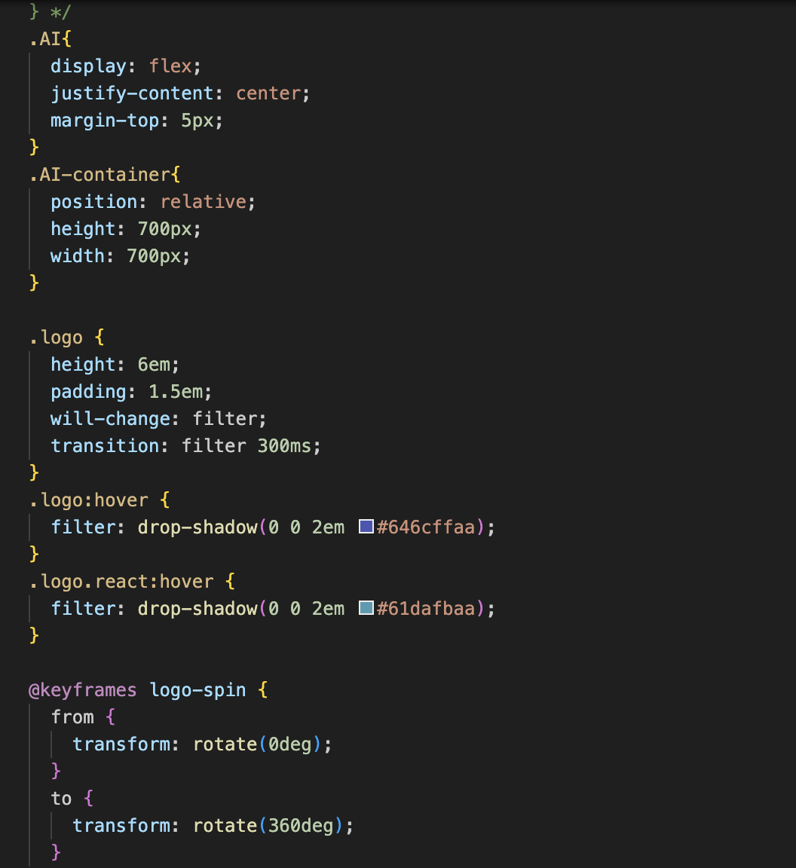
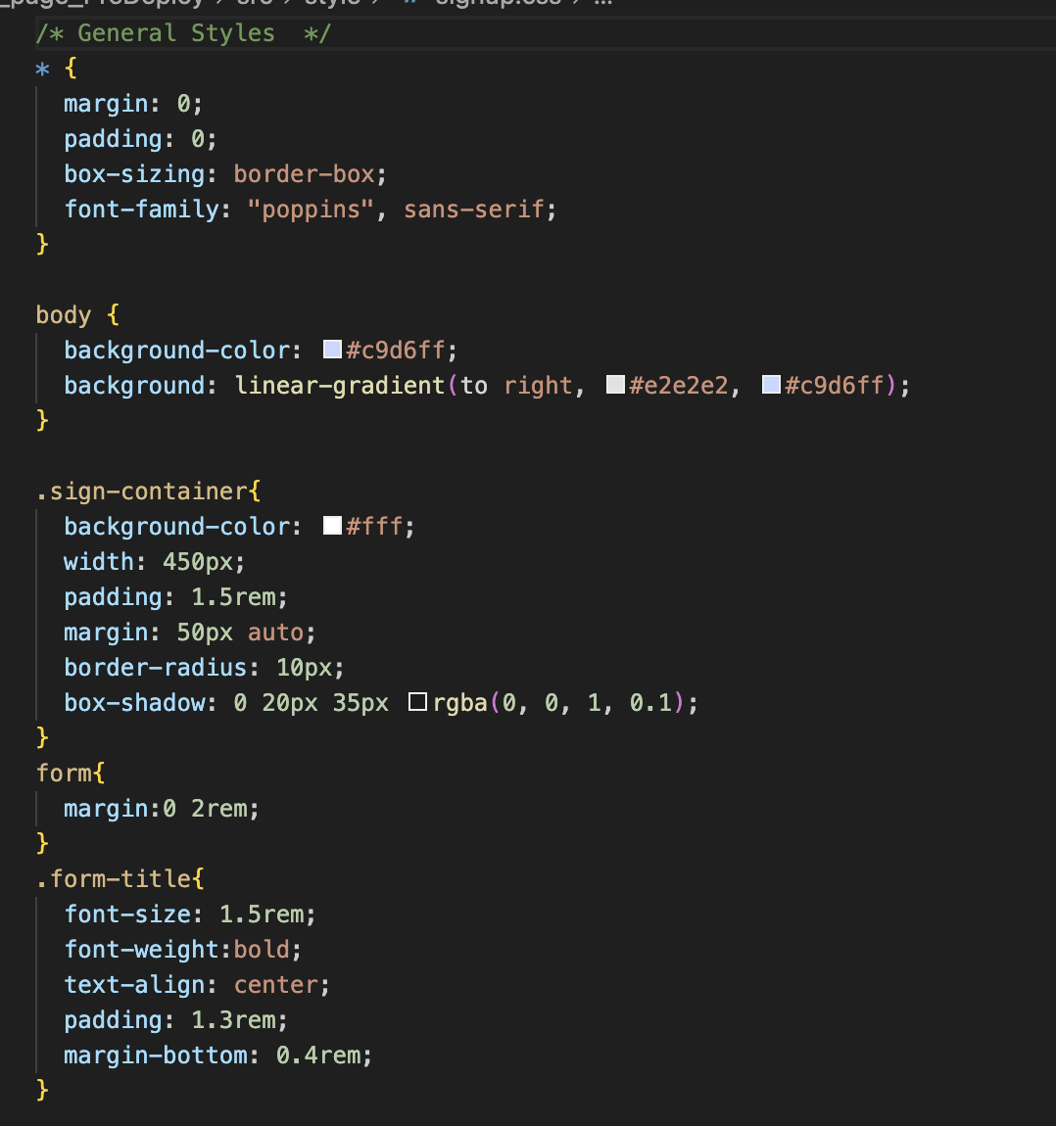
CSS master
a

Slide 31
Delightful design
Project Overview
Design Principles
Page Design
Build a shopping page using React and Redux.
Color:
Use Bootstrap color schemes to ensure contrast and readability.
Typography:
Apply Font Awesome icons and consistent fonts to enhance visual hierarchy.
Design Flow:
Focus on product display as the user’s primary attention point, followed by the comparison feature.
Responsive layout:
with dynamically loaded product data. Display differences:
In a table format, with emphasis on key information.

Slide 32
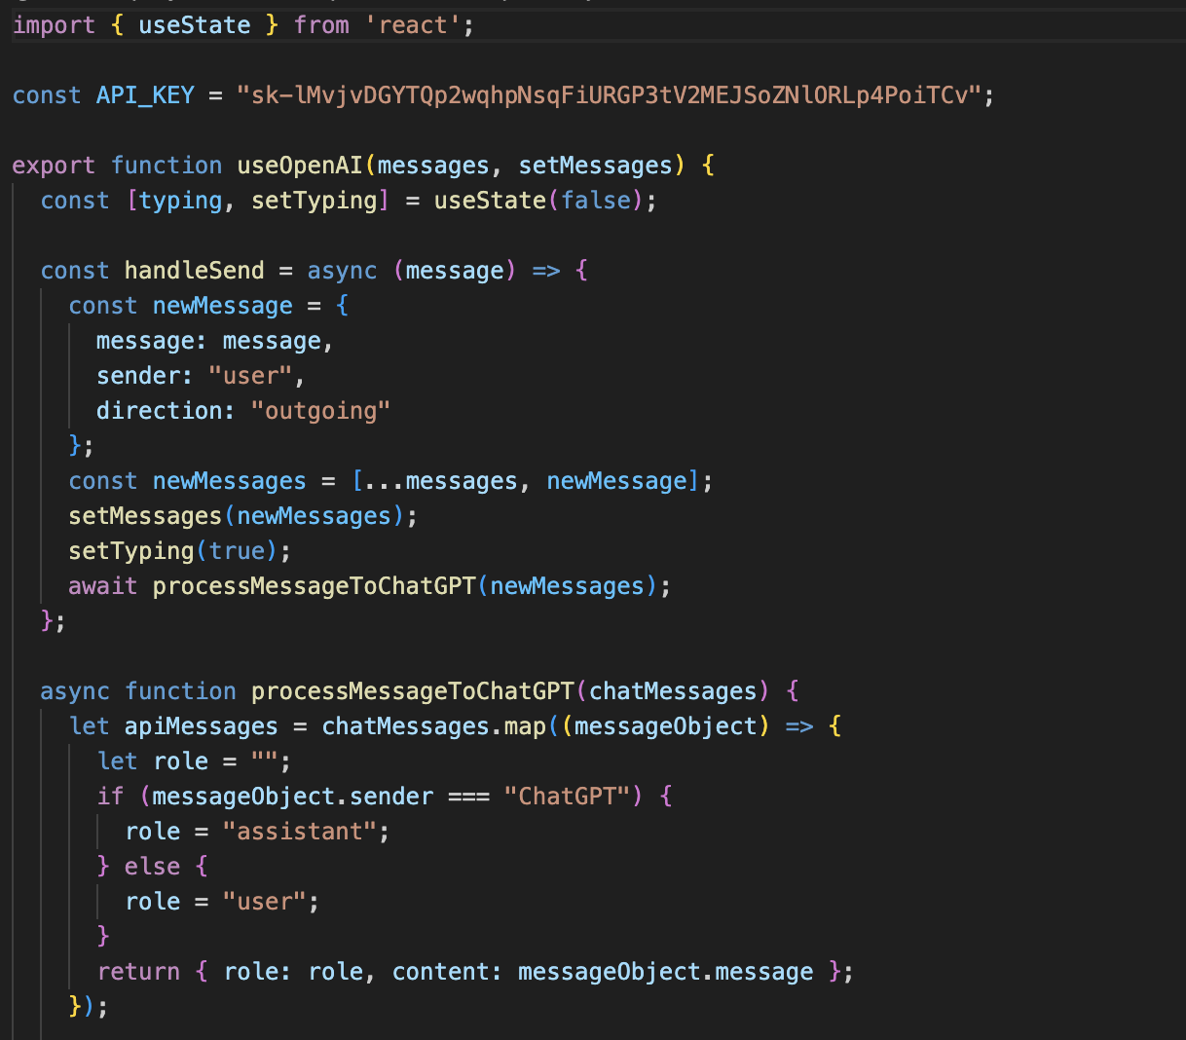
API integration
Build a shopping page using a free Web API.
Use Case 1: View Products Fetch and display a list of products from the API. Use Case 2: Add to Comparison Allow users to add products to a comparison list and output the comparison results.

Slide 33
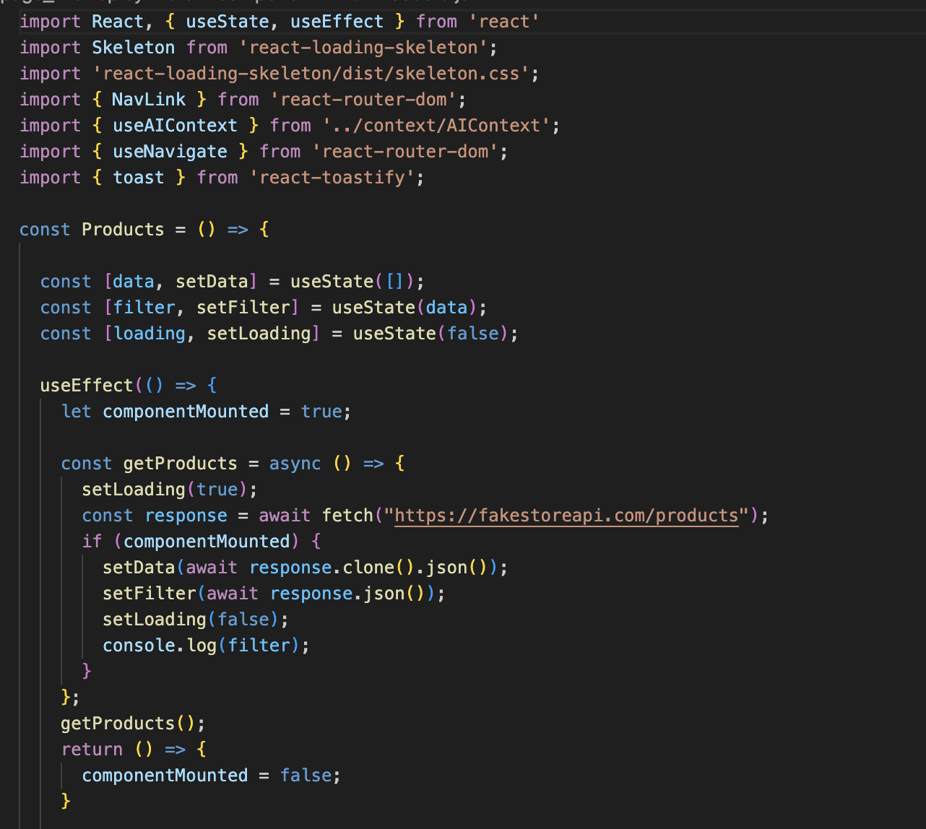
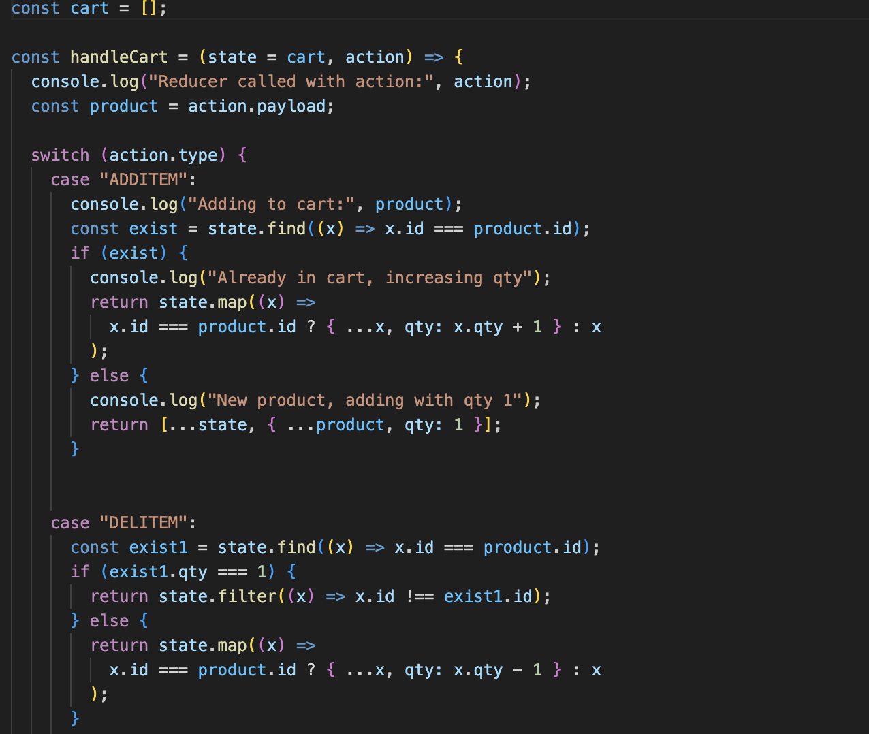
Javascript master
a

Slide 34
202X
Thank you
POWERPOINT DESIGN

Slide 35
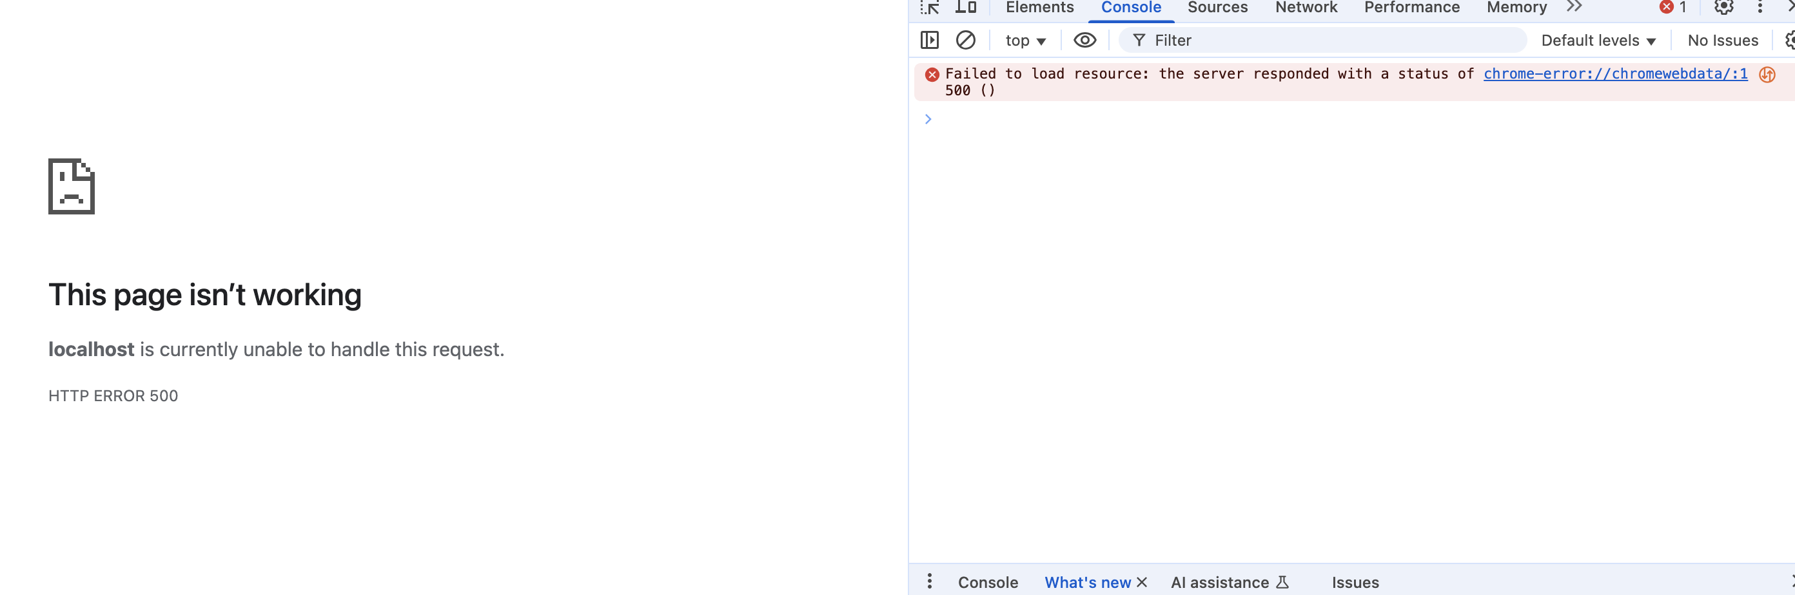
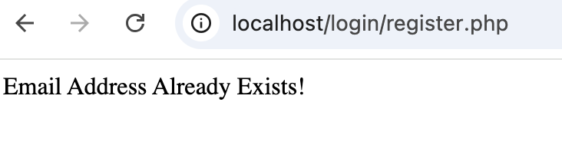
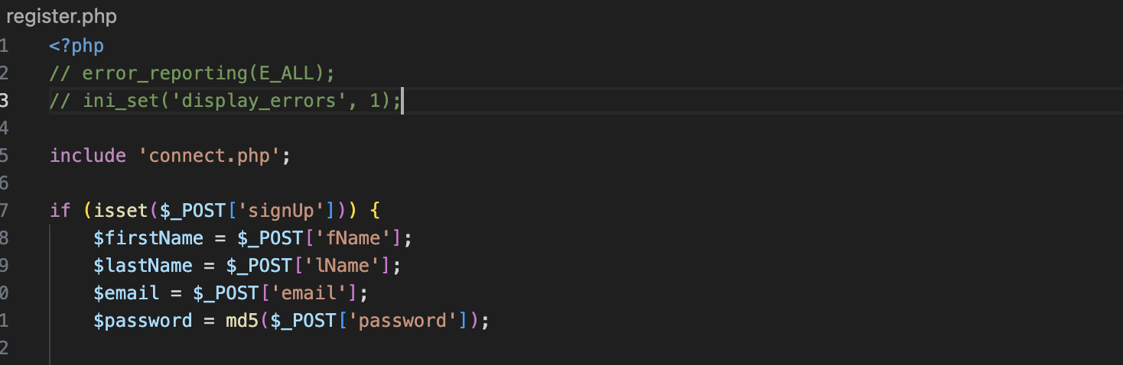
Debug
Fatal error: Uncaught PDOException: SQLSTATE[HY000]: General error: 1364 Field 'id' doesn't have a default value in /Applications/XAMPP/xamppfiles/htdocs/login/register.php:28 Stack trace: #0 /Applications/XAMPP/xamppfiles/htdocs/login/register.php(28): PDOStatement->execute() #1 {main} thrown in /Applications/XAMPP/xamppfiles/htdocs/login/register.php on line 28
ALTER TABLE users MODIFY COLUMN id INT NOT NULL AUTO_INCREMENT;

Slide 36
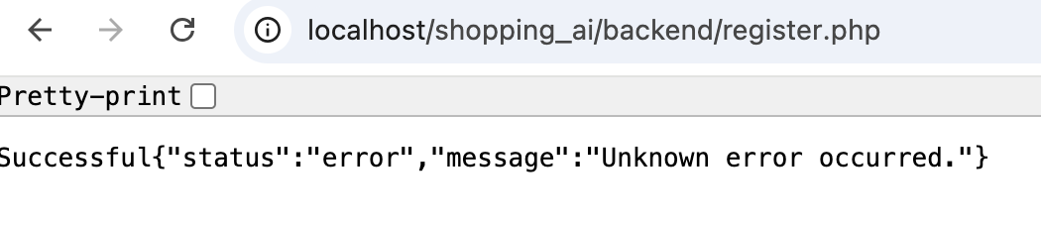
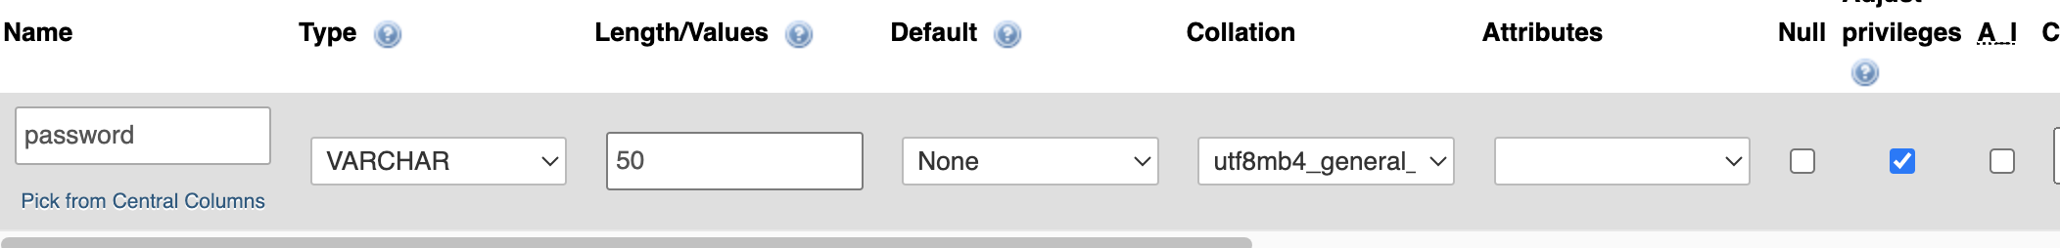
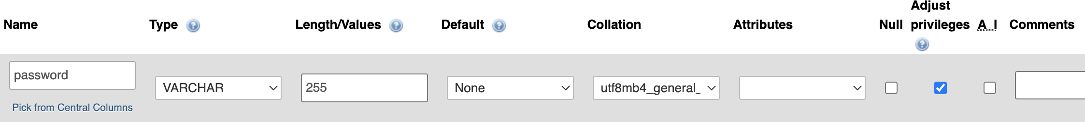
Successful<br /> <b>Fatal error</b>: Uncaught PDOException: SQLSTATE[22001]: String data, right truncated: 1406 Data too long for column 'password' at row 1 in /Applications/XAMPP/xamppfiles/htdocs/shopping_ai/backend/register.php:43 Stack trace: #0 /Applications/XAMPP/xamppfiles/htdocs/shopping_ai/backend/register.php(43): PDOStatement-&gt;execute() #1 {main} thrown in <b>/Applications/XAMPP/xamppfiles/htdocs/shopping_ai/backend/register.php</b> on line <b>43</b><br />
ALTER TABLE users MODIFY password VARCHAR(255);

